Slide 1
Process
Operations on process

Slide 2
Process Creation
During the course of execution, a process may create several new processes. the creating process is called a parent process, and the new processes are called the children of that process. Each of these new processes may in turn create other processes, forming a tree of processes.

Slide 3
process identifier
Most operating systems (including UNIX, Linux, and Windows) identify processes according to a unique process identifier (or pid), which is typically an integer number.
The pid provides a unique value for each process in the system, and it can be used as an index to access various attributes of a process within the kernel.

Slide 4
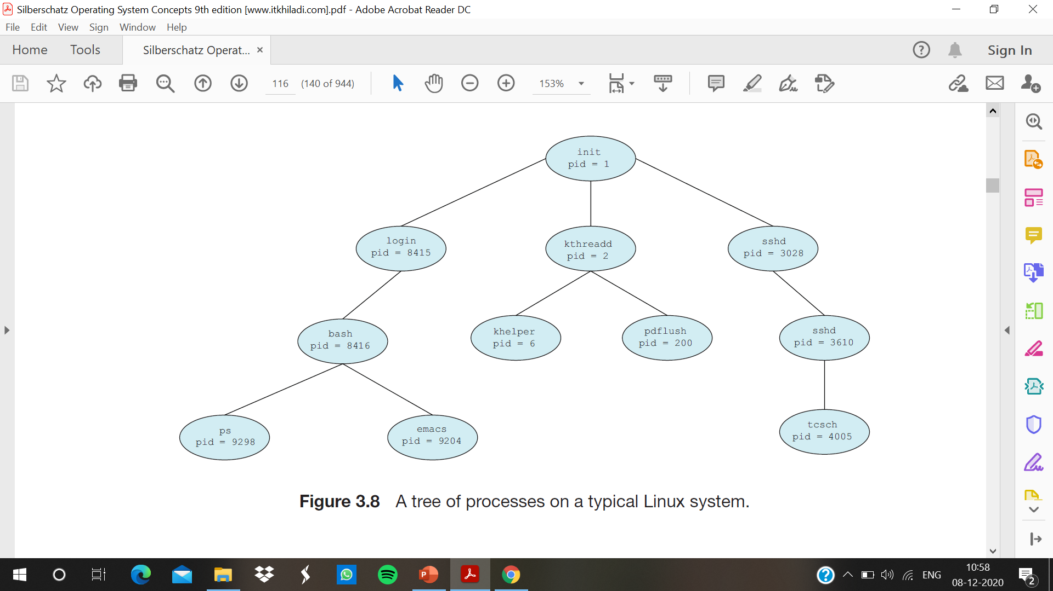

Slide 5
Description of the diagram
The init process (which always has a pid of 1) serves as the root parent process for all user processes. Once the system has booted, the init process can also create various user processes, such as web or print server, an ssh server, and the like.
Two children of init—kthreadd and sshd.
The kthreadd process is responsible for creating additional processes that perform tasks on behalf of the kernel (in this situation, khelper and pdflush).
The sshd process is responsible for managing clients that connect to the system by using ssh (which is short for secure shell).
The login process is responsible for managing clients that directly log onto the system. In this example, a client has logged on and is using the bash shell, which has been assigned pid 8416. Using the bash command-line interface, this user has created the process ps as well as the emacs editor.

Slide 6
How a child process gets resources ?
In general, when a process creates a child process, that child process will need certain resources (CPU time, memory, files, I/O devices) to accomplish its task.
A child process may be able to obtain its resources directly from the operating system, or it may be constrained to a subset of the resources of the parent process. The parent may have to partition its resources among its children, or it may be able to share some resources (such as memory or files) among several of its children.
Restricting a child process to a subset of the parent’s resources prevents any process from overloading the system by creating too many child processes.
In addition to supplying various physical and logical resources, the parent process may pass along initialization data (input) to the child process.

Slide 7
When a process creates a new process, two possibilities for execution exist:
1. The parent continues to execute concurrently with its children.
2. The parent waits until some or all of its children have terminated.
There are also two address-space possibilities for the new process:
1. The child process is a duplicate of the parent process (it has the same program and data as the parent).
2. The child process has a new program loaded into it.

Slide 8
Process Termination
A process terminates when it finishes executing its final statement and asks the operating system to delete it by using the exit() system call.
At that point, the process may return a status value (typically an integer) to its parent process (via the wait() system call).
All the resources of the process—including physical and virtual memory, open files, and I/O buffers—are deallocated by the operating system.
Termination can occur in other circumstances as well. A process can cause the termination of another process via an appropriate system call

Slide 9
Termination of child process
Usually, such a system call can be invoked only by the parent of the process that is to be terminated. Otherwise, users could arbitrarily kill each other’s jobs.
Note that a parent needs to know the identities of its children if it is to terminate them. Thus, when one process creates a new process, the identity of the newly created process is passed to the parent.
Some systems do not allow a child to exist if its parent has terminated. In such systems, if a process terminates (either normally or abnormally), then all its children must also be terminated. This phenomenon, referred to as cascading termination, is normally initiated by the operating system

Slide 10
A parent may terminate the execution of one of its children for a variety of reasons, such as these:
The child has exceeded its usage of some of the resources that it has been allocated. (To determine whether this has occurred, the parent must have a mechanism to inspect the state of its children.)
The task assigned to the child is no longer required.
The parent is exiting, and the operating system does not allow a child to continue if its parent terminates.

Slide 11
a zombie process
A process that has terminated, but whose parent has not yet called wait(), is known as a zombie process.
All processes transition to this state when they terminate, but generally they exist as zombies only briefly.
Once the parent calls wait(), the process identifier of the zombie process and its entry in the process table are released.

Slide 12
Orphan process
if a parent did not invoke wait() and instead terminated, thereby leaving its child processes as orphans.
Linux and UNIX address this scenario by assigning the init process as the new parent to orphan processes.
The init process periodically invokes wait(), thereby allowing the exit status of any orphaned process to be collected and releasing the orphan’s process identifier and process-table entry.

